Slide 1
Detecting Deauthentication in Open Network : A Security Enhanced Approach
20IT603L – Mini Project-II
TEAM MEMBERS: GUIDE:
MOHAMED FAIZE A(621323205028) Dr.K.MUTHUMANICKAM, ME, Phd.,
THIRUVIKRAM S (621323205059) Professor / IT
KABILAN M (621323205303)

Slide 2
Table of Contents
S.NO | TOPIC | Page.No
1. | Title Confirmation
2. | Introduction
3. | Objective of the Project
4. | Literature Review
5. | Summary of Literature Review
6. | Existing System
7. | Disadvantages
8. | Proposed System with Architecture
9. | Advantages
10. | Architecture Diagram
11. | All Modules – Working Principle of each module

Slide 3
12. | Implementation of each module
13. | Software and Hardware Requirement Specification
14. | Results and Discussion with Graphs/screenshots
15. | Conclusion
16. | References

Slide 4
Title Confirmation
Detecting Deauthentication in Open Networks: A Security-Enhanced Approach
This title is finalized and confirmed as it accurately reflects the objective of the project. The focus is on detecting deauthentication attacks in open Wi-Fi networks using a security-enhanced and ethical approach.
The title avoids attack execution and emphasizes intrusion detection, user alerting, and security awareness, making it suitable for academic research, demonstrations, and real-world applications.

Slide 5
Introduction
Open Wi-Fi networks are widely used in colleges and public areas
These networks lack strong security protection
One major threat is deauthentication attack
Attackers send fake packets to disconnect users
This causes network disruption and denial of service
It can also lead to phishing and credential theft

Slide 6
Objectives of the Project
Detect deauthentication attacks in real-time
Monitor all nearby Wi-Fi networks continuously
Analyze packet patterns using threshold logic
Reduce false alerts uemailsing RSSI filtering
Identify spoof attacks using MAC comparison
Provide alerts through OLED, buzzer, and email

Slide 7
Literature Review
S-no | Author & Year of Publications | Journal | Title of paper | Advantages | Limitations
1 | Moharam, M. H., Ashraf, K., Alaa, H. et al. 2025 | Scientific reports | Real-time detection of Wi-Fi attacks using hybrid deep learning models on NodeMCU | High (>96%) accuracy; interpretable hybrid ML + DL; low-cost deployment | Heavy computation for ultra-low-end IoT; sensitive to RSSI/SNR noise
2 | Btoush, A., Abdallah, A., et al.2024 | Springer | Intrusion detection and recovery framework for WPA3-SAE deauthentication frames | Introduces proactive detection and recovery mechanisms; focuses on modern WPA3 security | Limited experimental evaluation metrics; less focus on lightweight deployment

Slide 8
Contd.
3 | Behiry, M. H., & Aly, M.2024 | Springer – Journal of Big Data | Hybrid feature selection with ML-based intrusion detection | Improved detection accuracy in wireless networks; efficient feature reduction | Not exclusively focused on Wi-Fi deauthentication attacks
4 | Yu, Y., Fu, Y., Liu, T., et al.2025 | Scientific Reports | Deep learning-based intrusion detection framework for IoT | High detection accuracy for network attacks; scalable deep learning model | General IoT attack detection; not specific to Wi-Fi deauthentication attacks

Slide 9
Contd.
5 | Liu X., Meng X., Duan H., Hu Z., Wang M.2025 | Sensors (MDPI) | A Survey on Secure Wi-Fi Sensing Technology: Attacks & Defenses | Comprehensive background survey; covers multiple Wi-Fi attacks | Broad scope; not focused solely on deauthentication detection
6 | Yogi Kristyanto, Ernastuti | CommIT Journal | Analysis of Deauthentication Attack on IEEE 802.11 Connectivity (IoT) | Real attack behavior analysis; IoT-oriented study | No advanced detection model; mainly penetration analysis

Slide 10
Contd.
7 | L. R. & R. M. Bommi 2023 | ICSTCEE 2022 Conference | Deauthentication Attack Detection using ML Techniques | Early ML-based approach; baseline classification results | Conference paper; limited dataset and real-world validation
8 | Alaa Btoush, Abdallah et al. 2024 | Springer | Intrusion Detection & Recovery of Deauthentication Frame in WPA3-SAE | Combines detection and recovery; WPA3-focused security | Less emphasis on performance metrics; partial indexing

Slide 11
Contd.
9 | Alkasasbeh, Btoush, Anas A. et al. 2024 | RSCom / Preprint | Intrusion Detection & Recovery for WPA3 Deauthentication Frames | Integrated detection + recovery approach | Preprint; broader than pure detection analysis
10 | Md Minhajul Islam Munna et al.2025 | arXiv(preprint) | Intrusion Detection with Advanced ML in Wi-Fi Networks | Very high accuracy (>98%); ensemble ML models | Preprint only; not peer-reviewed; broad intrusion scope

Slide 12
Findings
Machine learning models improve attack detection accuracy significantly
Deep learning techniques are used for complex network behavior analysis
Centralized Wireless Intrusion Detection Systems (WIDS) are widely deployed
Software tools like Wireshark and Aircrack-ng are effective for packet analysis
Deauthentication attacks are easy to execute due to protocol weakness
IoT-based monitoring systems are emerging in recent research
Threshold-based detection methods are simple and fast
Hybrid detection (ML + rule-based) improves reliability
WPA3 improves security but still vulnerable at management frame level
Real-time detection is possible but mostly in high-end systems

Slide 13
Gaps
Most systems are expensive and require dedicated infrastructure
Lack of portable and standalone detection solutions
Existing methods depend on laptops and external adapters
Limited real-time embedded system implementations
Poor detection of spoof (fake MAC) attacks
High computational requirement for ML-based systems
Not suitable for small-scale environments like colleges
Many systems focus on attack execution rather than detection
Lack of user-friendly alert mechanisms
Limited research on low-cost IoT-based intrusion detection

Slide 14
Summary of Literature Review
systems are powerful but expensive
Existing systems are powerful but expensive
Most solutions require laptops or servers
Embedded real-time detection is limited
Need for low-cost

Slide 15
Existing System
Uses tools like Wireshark, Kali Linux
Requires monitor mode adapters
Performs packet capture and analysis
Used mainly by cybersecurity professionals

Slide 16
Disadvantages
Not portable (requires laptop setup)
High cost of equipment
Requires technical expertise
No real-time alert system
Limited usability in college environments

Slide 17
Proposed System
ESP32-based embedded detection system
Works in promiscuous mode
Captures all nearby Wi-Fi packets
Uses hybrid detection (count + rate + spoof)
Generates real-time alerts

Slide 18
Advantages
Low-cost (~₹1000)
Portable and standalone system
Real-time monitoring
Easy to use
Detects multiple attackers
Works without external system

Slide 19
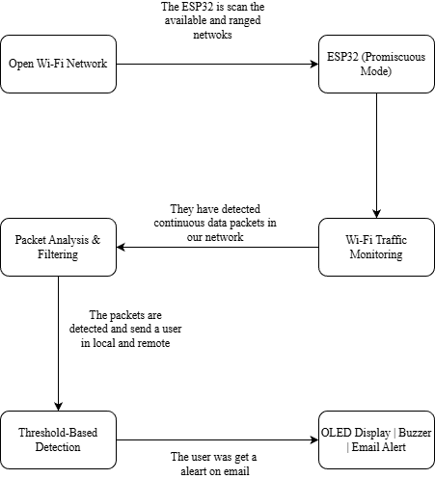
Architecture Diagram

Slide 20
Contd.
ESP32 captures Wi-Fi packets
Detection engine processes packets
Filters unwanted signals (RSSI filtering)
Applies detection logic
Alerts user via OLED, buzzer, email

Slide 21
Modules – working principle of the each Modules
Packet Sniffing Module
Captures Wi-Fi packets using ESP32
Works in promiscuous mode
Packet Filtering Module
Filters deauthentication frames
Removes weak signals
Detection Module
Counts deauth packets
Calculates rate

Slide 22
Contd.
Spoof Detection Module
Compares MAC with router database
Detects fake routers
Alert Module
OLED → display alert
Buzzer → sound alert
Email → remote alert

Slide 23
Implementation of Each Module
ESP32 configured in promiscuous mode
Packet capture using Wi-Fi API
Deauth frames identified (subtype = 12)
Sliding window (5 sec) used for rate calculation
Threshold set: 30 packets / 20 packets/sec
Spoof detection using router MAC comparison
Email sent using SMTP protocol

Slide 24
Software & Hardware Requirement Specification
Hardware:
ESP32 microcontroller
OLED display (128×64)
Buzzer
Power supply

Slide 25
Contd.
Software:
Arduino IDE
ESP32 Wi-Fi libraries
ESP Mail Client
Adafruit OLED library

Slide 26
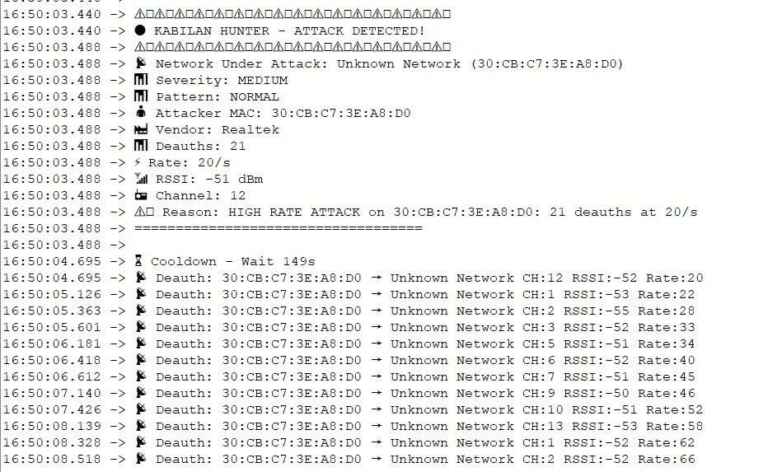
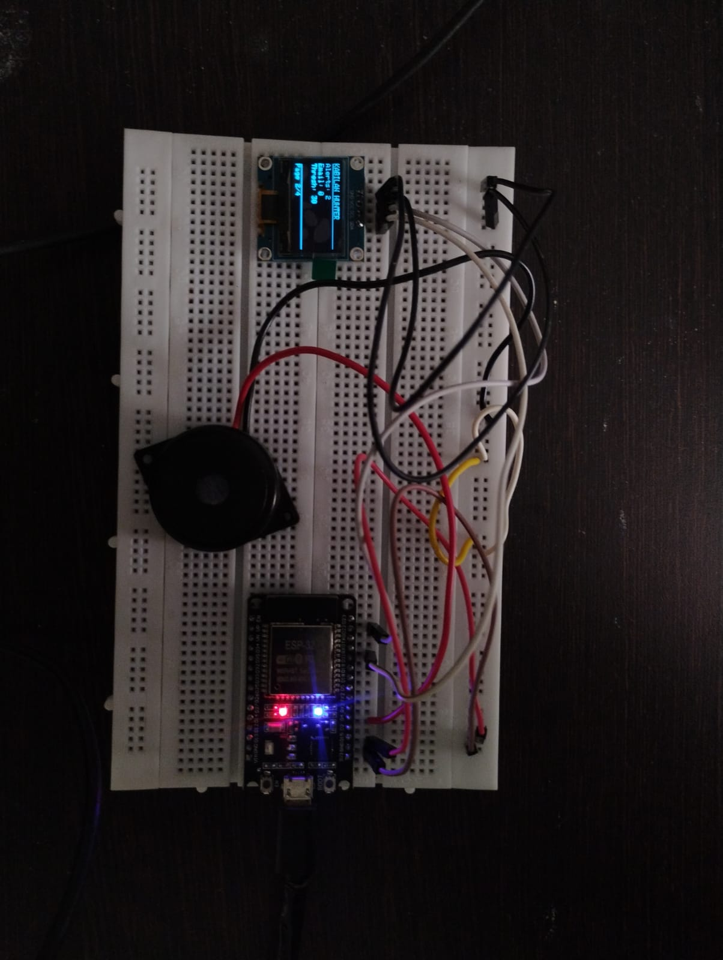
Result and Discussion with Screenshot

Slide 27

Contd.

Slide 28
Conclusion
Conclusion:
Successfully detects deauthentication attacks
Works in real-time
Low-cost and efficient solution
Future Work:
Machine learning integration
Multi-device monitoring
Cloud dashboard
Automatic attack prevention

Slide 29
References
1. Moharam, M. H., Ashraf, K., Alaa, H., et al. (2025) ‘Real-time detection of Wi-Fi attacks using hybrid deep learning models on NodeMCU’, Scientific Reports, Vol. 15, No. 1, pp. 1–15.
2. Yu, Y., Fu, Y., Liu, T., et al. (2025) ‘Attack detection based on deep learning for IoT’, Scientific Reports, Vol. 15, No. 1, pp. 1–18.
3. Liu, X., Meng, X., Duan, H., Hu, Z. and Wang, M. (2025) ‘A survey on secure Wi-Fi sensing technology: attacks and defenses’, Sensors (MDPI), Vol. 25, No. 6, pp. 1913–1935.

Slide 30
Contd.
4. Btoush, A., Abdallah, A., et al. (2024) ‘Intrusion detection and recovery of deauthentication frames in WPA3-SAE’, Wireless Networks, Springer, Vol. 30, No. 4, pp. 2157–2172.
5. Behiry, M. H. and Aly, M. (2024) ‘Cyberattack detection in wireless networks using hybrid machine learning techniques’, Journal of Big Data, Springer, Vol. 11, Article No. 16, pp. 1–22.
6. Alkasasbeh, A. A., Btoush, A., and Al-Shawabkeh, A. (2024) ‘Wireless intrusion detection systems for IEEE 802.11 networks: challenges solutions’, Security and Communication Networks, Springer, Vol. 2024, Article ID 8893146, pp. 1–14.

Slide 31
Contd.
7. Dalal, N., Akhtar, N., Gupta, A., et al. (2023) ‘Detection of management frame attacks in IEEE 802.11 wireless networks’, Wireless Personal Communications, Springer, Vol. 129, No. 2, pp. 835–852.
8. Kim, J., Park, J., and Lee, H. (2023) ‘Machine learning-based intrusion detection for wireless local area networks’, Sensors (MDPI), Vol. 23, No. 9, pp. 4217–4234.
9. Zhang, Y., Wang, S., and Chen, X. (2024) ‘Lightweight intrusion detection framework for IoT-enabled wireless networks’, Scientific Reports, Vol. 14, No. 1, pp. 1–13.

Slide 32
Contd.
10. Rahman, M. A., Hossain, M. S., and Hassan, M. M. (2023) ‘Anomaly detection in wireless IoT networks using hybrid deep learning’, Sensors (MDPI), Vol. 23, No. 14, pp. 6421–6439.

Slide 33
Thank You!!!

